Slide 1
Visualization Techniques
SSEP 2022 Morning Day 5
Dr. Ab Mosca (they/them)
Slides based on slides courtesy of Jordan Crouser: https://jcrouser.github.io/MassMutual-IntroR/, https://jcrouser.github.io/MassMutual-DataVis/, https://beanumber.github.io/sds192/

Slide 2
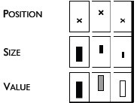
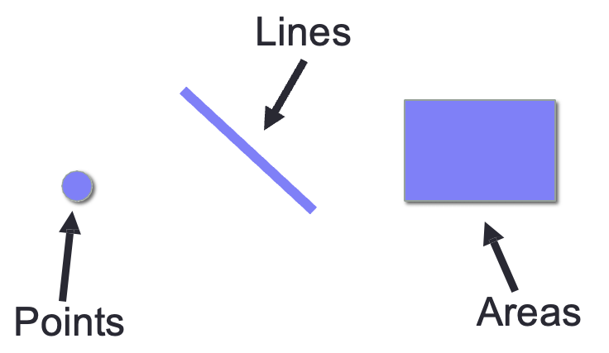
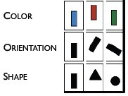
Recall
Visualizations (i.e. visual encodings) are made up of marks and channels
We select marks and channels based on goals, data, and other principles
Channels
Marks
Jacques Bertin, Semiologie Graphique
(Semiology of Graphics), 1967.

Slide 3
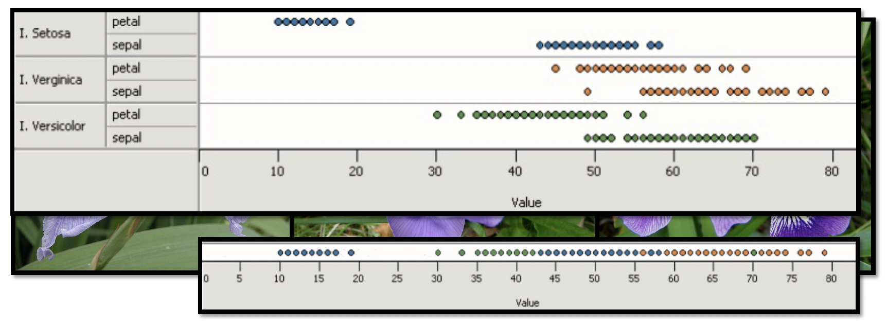
Mapping Data → Visuals
Principle 1: Expressiveness
Encode all the facts and only the facts
What data is in the top chart and not in the bottom chart?
Fig. Courtesy of M Krzywinski

Slide 4
Mapping Data → Visuals
Principle 1: Expressiveness
Encode all the facts and only the facts
What data is in the top chart and not in the bottom chart?
Fig. Courtesy of M Krzywinski

Slide 5
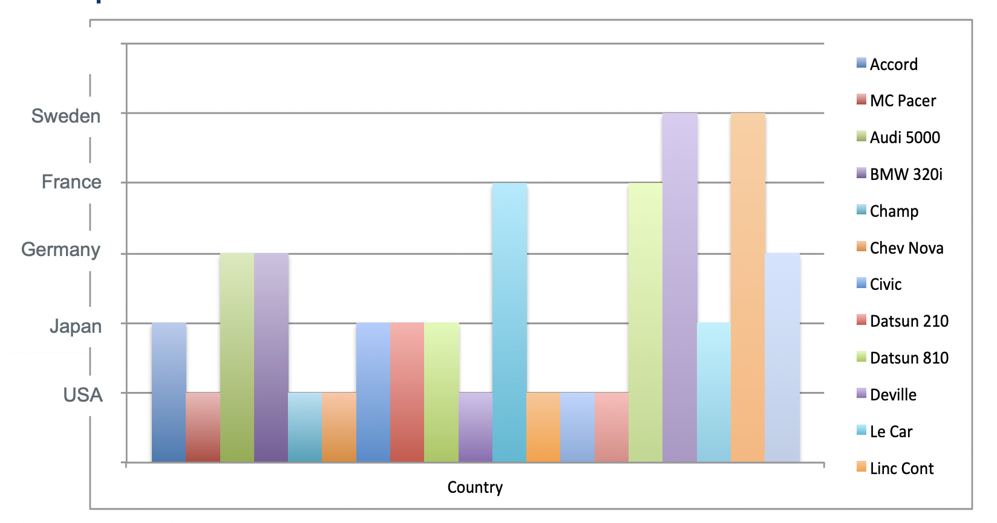
Mapping Data → Visuals
Principle 1: Expressiveness
Encode all the facts and only the facts
What “extra” data is included in this visualization?

Slide 6
Mapping Data → Visuals
Principle 1: Expressiveness
Encode all the facts and only the facts
What “extra facts” are included in this visualization?

Slide 7
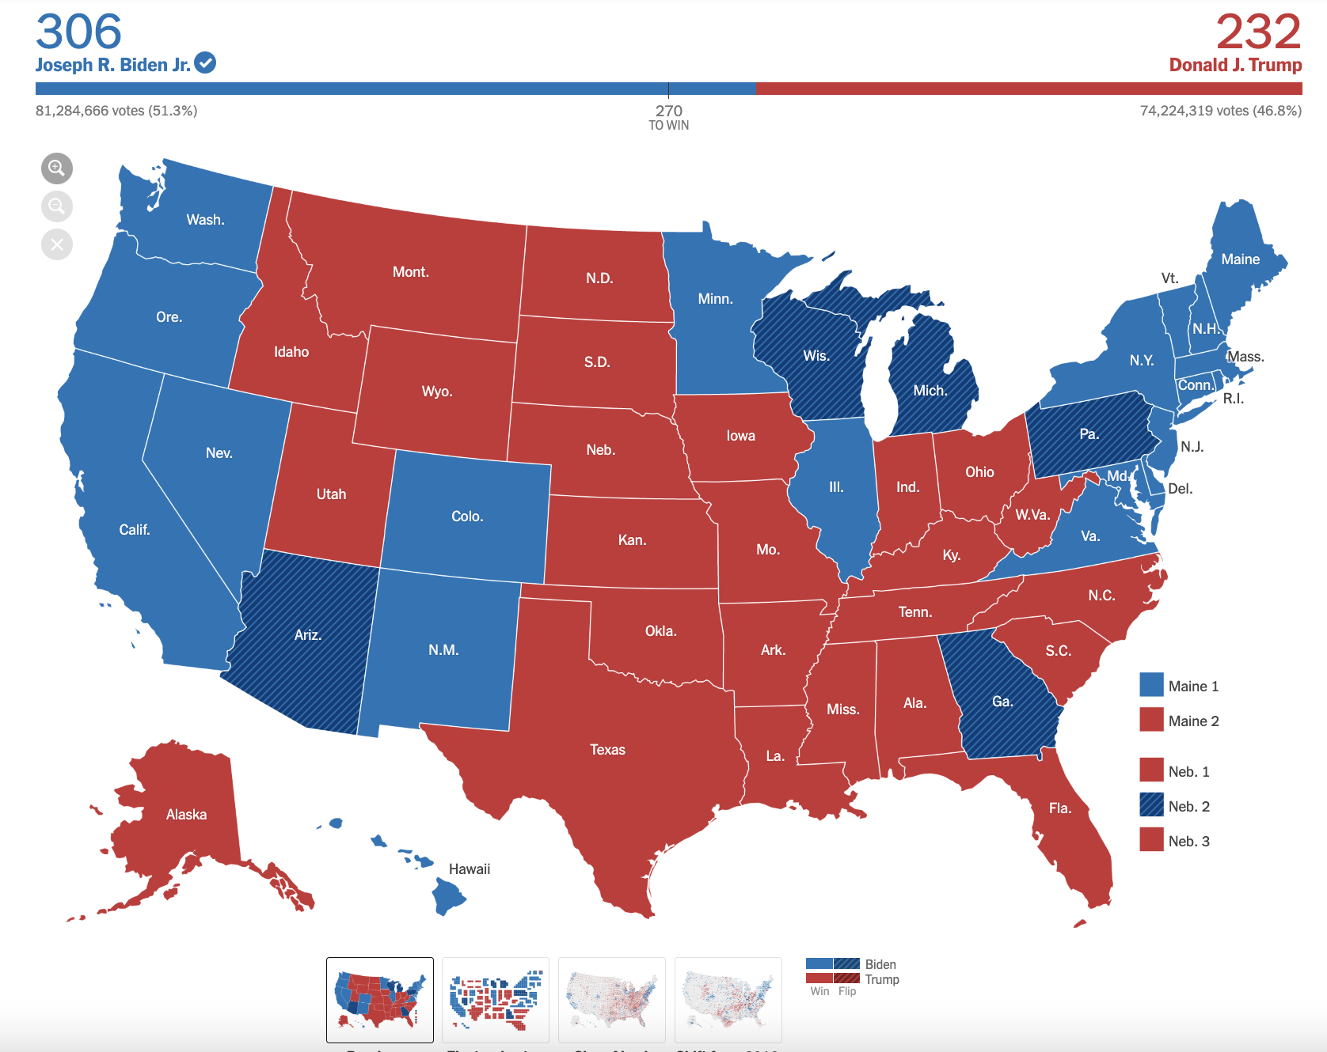
Mapping Data → Visuals
Principle 1: Expressiveness
Encode all the facts and only the facts
What is wrong with this visualization?
https://www.nytimes.com/interactive/2020/11/03/us/elections/results-president.html

Slide 8
Mapping Data → Visuals
Principle 1: Expressiveness
Encode all the facts and only the facts
Most electoral votes win
Colors highlight land area per state, not electoral votes
What is wrong with this visualization?
https://www.nytimes.com/interactive/2020/11/03/us/elections/results-president.html

Slide 9
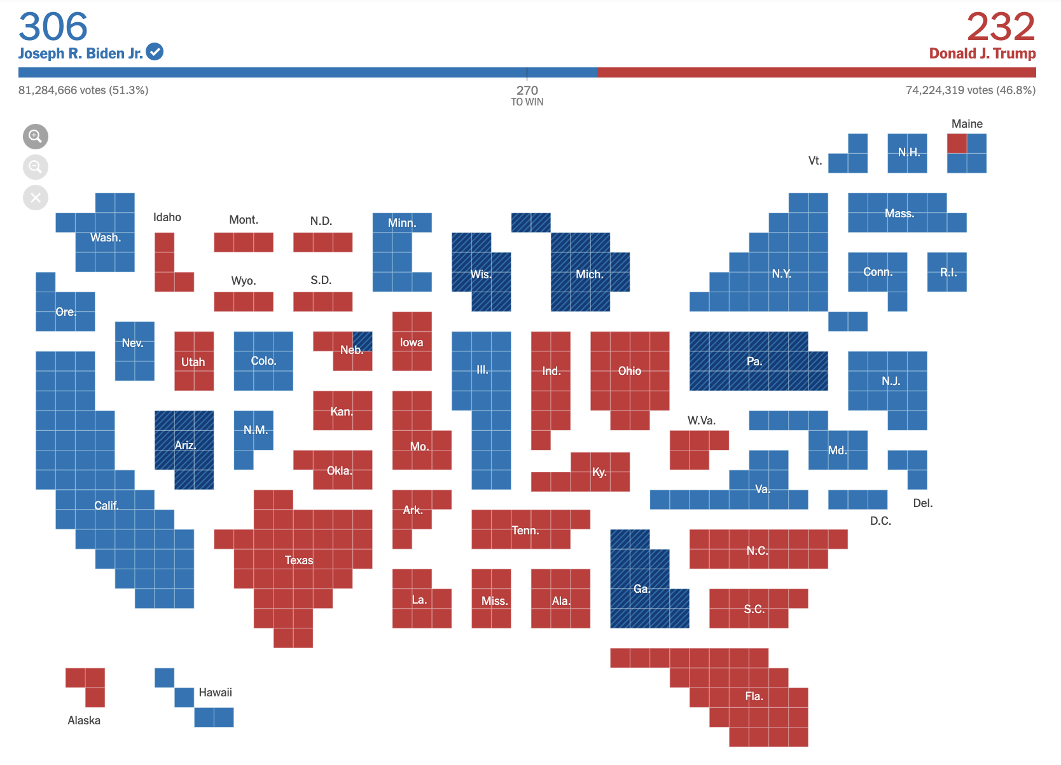
Mapping Data → Visuals
Principle 1: Expressiveness
Encode all the facts and only the facts
Most electoral votes win
Colors highlight electoral votes per state
https://www.nytimes.com/interactive/2020/11/03/us/elections/results-president.html

Slide 10
Mapping Data → Visuals
Principle 2: Effectiveness
Most effective channels should be used for most important data
Effectiveness = Based on a compilation of research, how well a channel supports:
Accuracy
Discriminability
Separability
Visual popout
Grouping

Slide 11
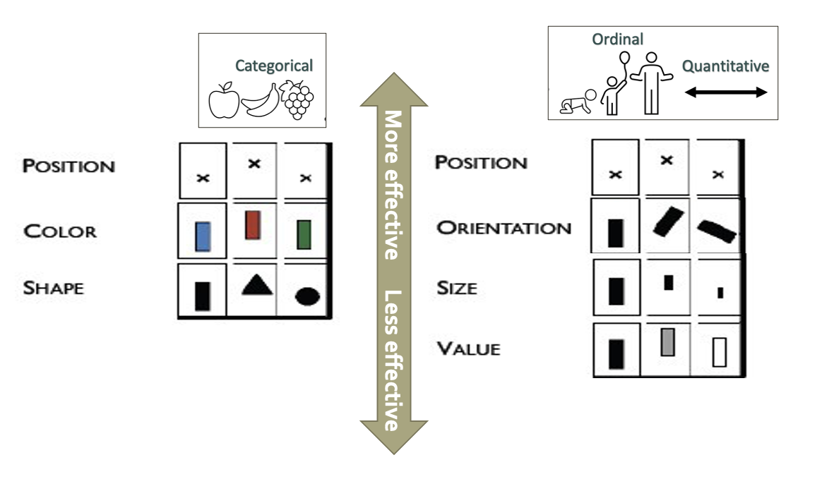
Mapping Data → Visuals
Principle 2: Effectiveness
Most effective channels should be used for most important data

Slide 12
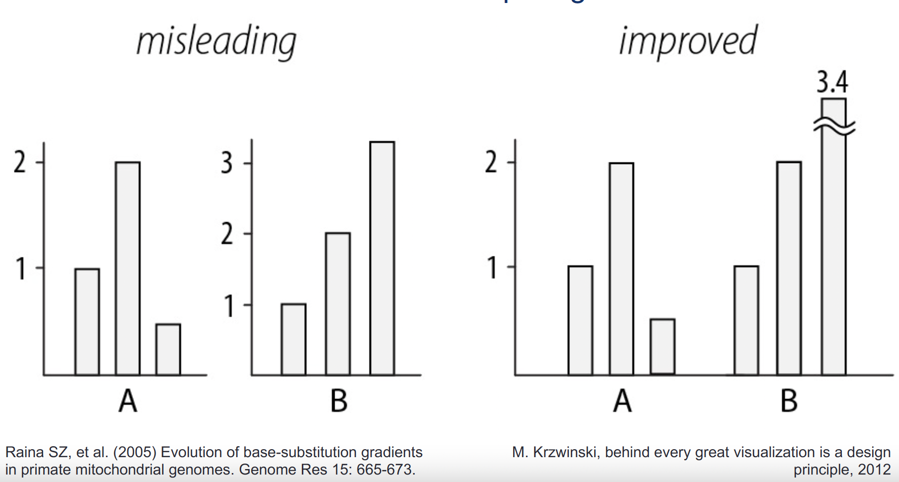
Mapping Data → Visuals
Principle 3: Consistency
Use consistent axes for comparisons

Slide 13
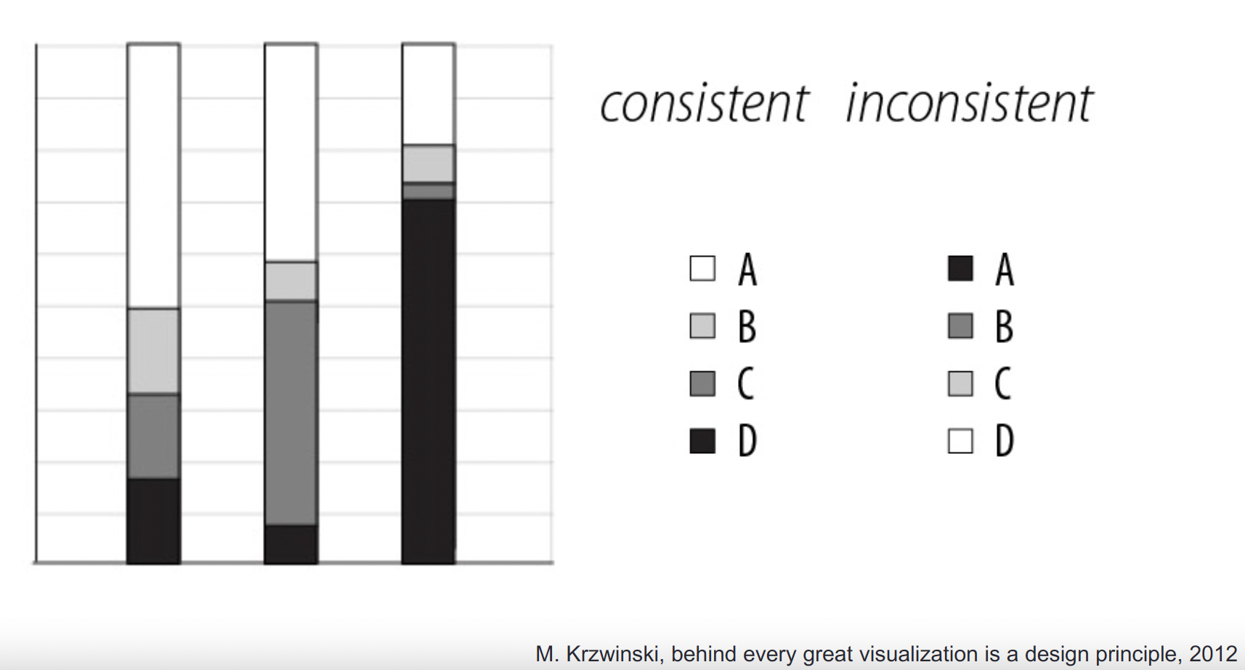
Mapping Data → Visuals
Principle 3: Consistency
Order legend items according to appearance

Slide 14
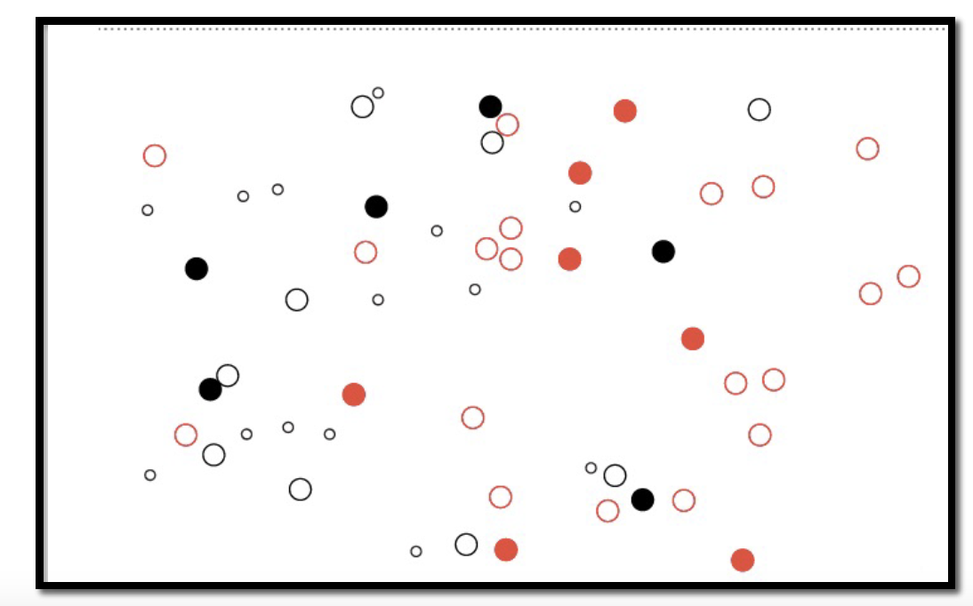
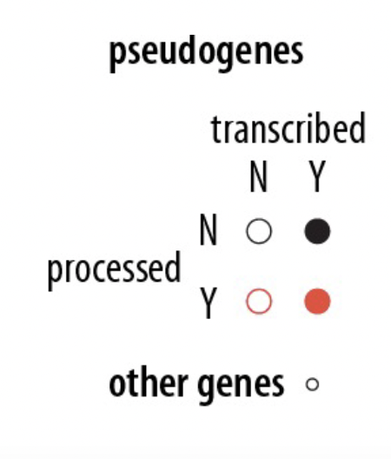
Mapping Data → Visuals
Principle 3: Separability
Avoid visually similar encodings for independent variables

Slide 15
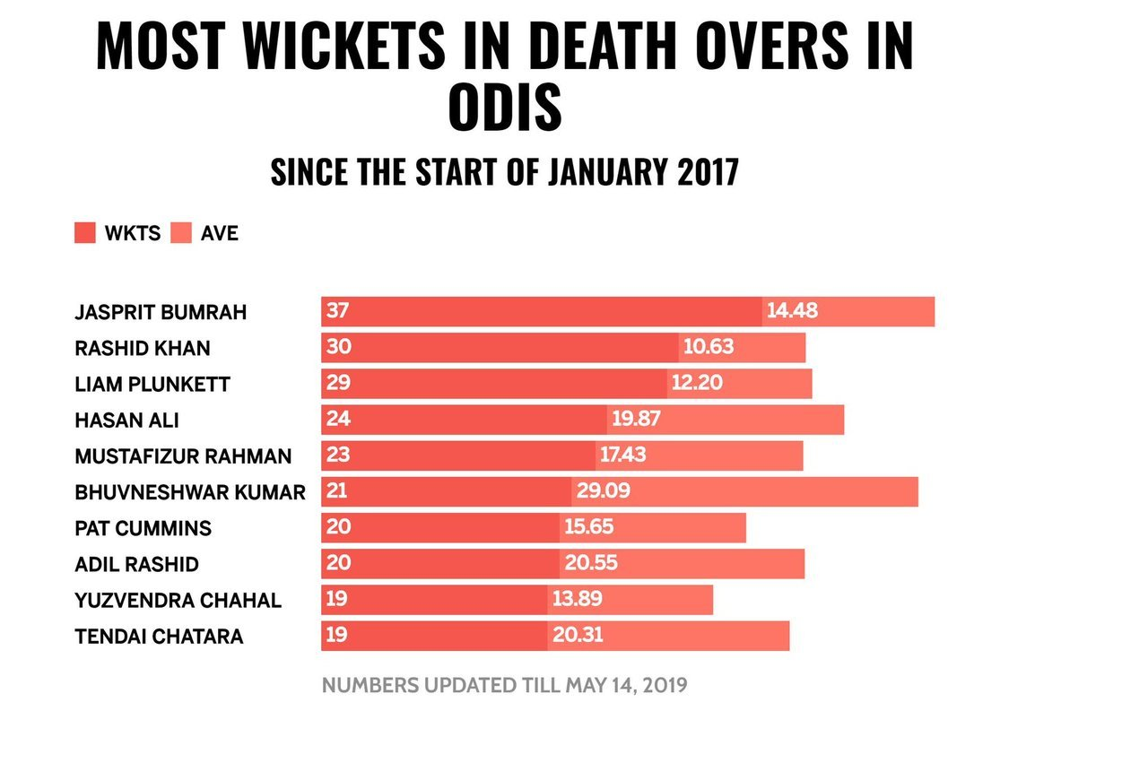
Mapping Data → Visuals
Principle 3: Separability
Avoid visually similar encodings for independent variables
https://www.syntaxtechs.com/blog/data-visualization-examples

Slide 16
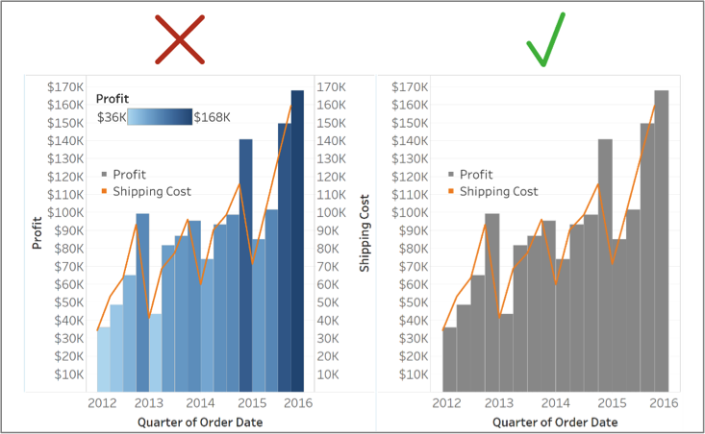
Mapping Data → Visuals
Principle 4: Simplicity
Avoid double encoding data
https://www.teknionusa.com/blog/the-10-commandments-of-visual-analytics-in-tableau

Slide 17
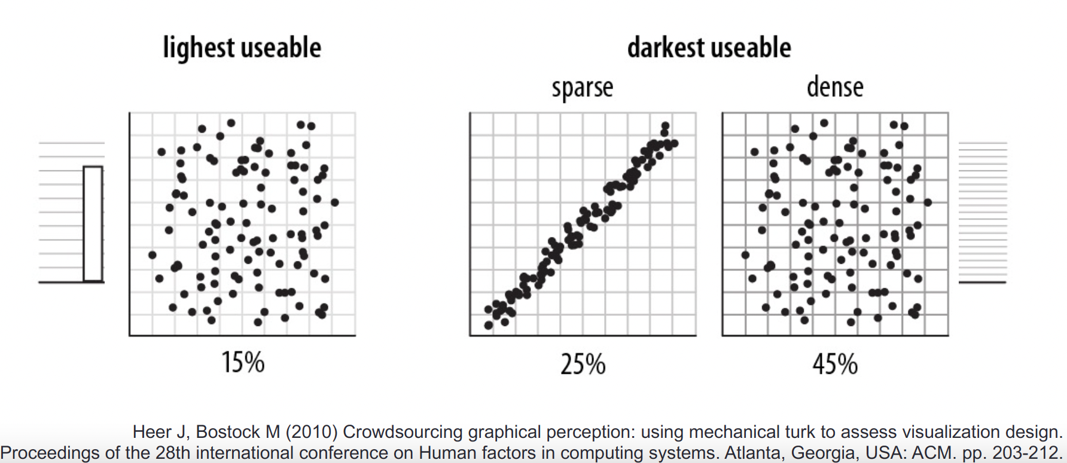
Mapping Data → Visuals
Principle 4: Simplicity
Navigational aids should not compete with data

Slide 18
Common Visualizations

Slide 19
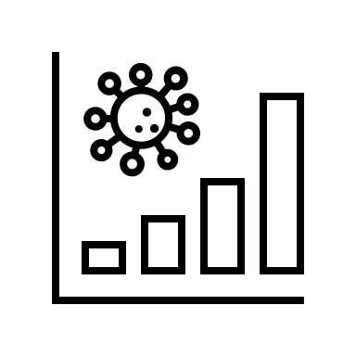
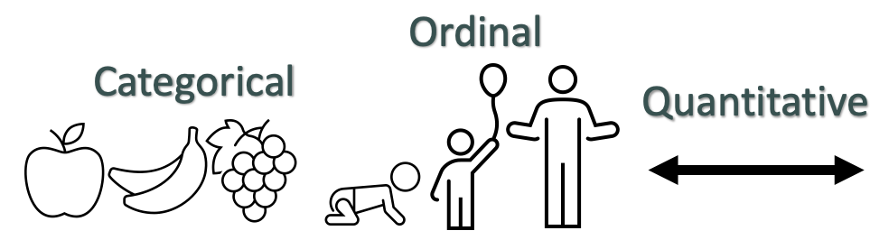
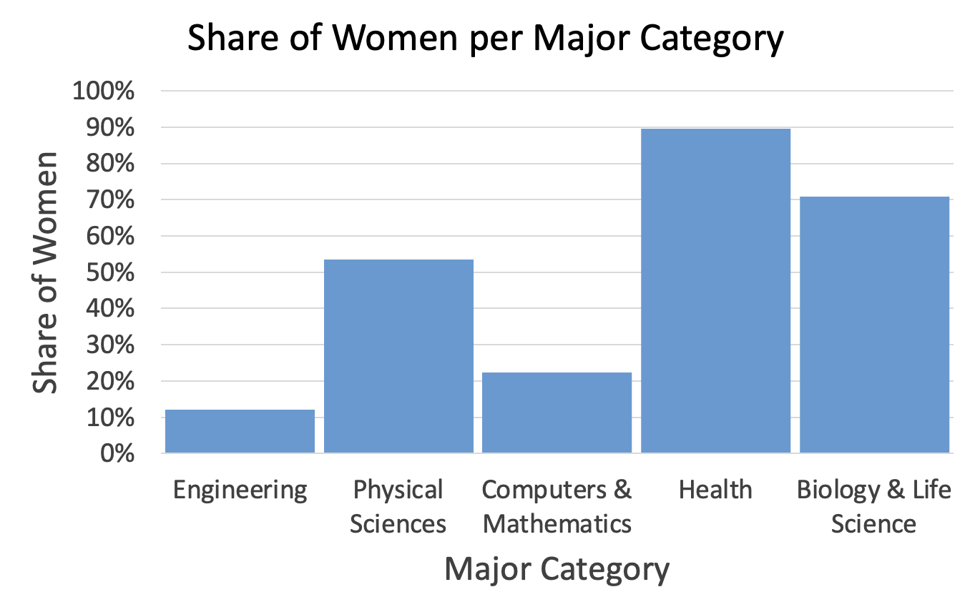
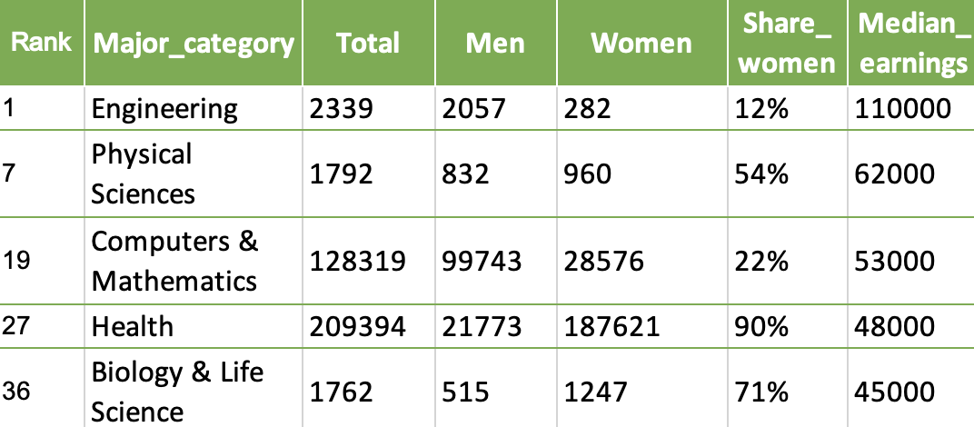
Bar charts
Goal → Comparison
Data Types → Categorical or Ordinal vs. Quantitative
Data: https://github.com/fivethirtyeight/data/blob/master/college-majors/women-stem.csv
Notes:
Let’s start by looking at bar charts.
We use bar charts when our goal is to enable comparisons of quantitative data between categorical or ordinal groups.
Let’s say for example that we want to compare share or women by major category from the previous dataset.
We can do this with a bar chart that shows our groups, major category, on the x-axis, and our quantitative data, share of women, on the y axis.
Notice how this set up makes it really easy to compare the share of women across these different majors.

Slide 20
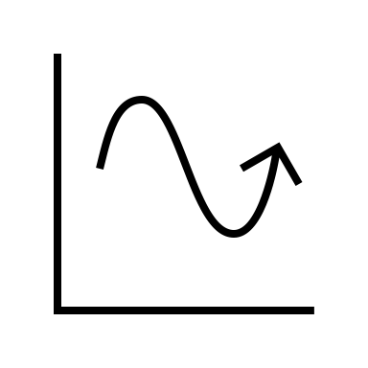
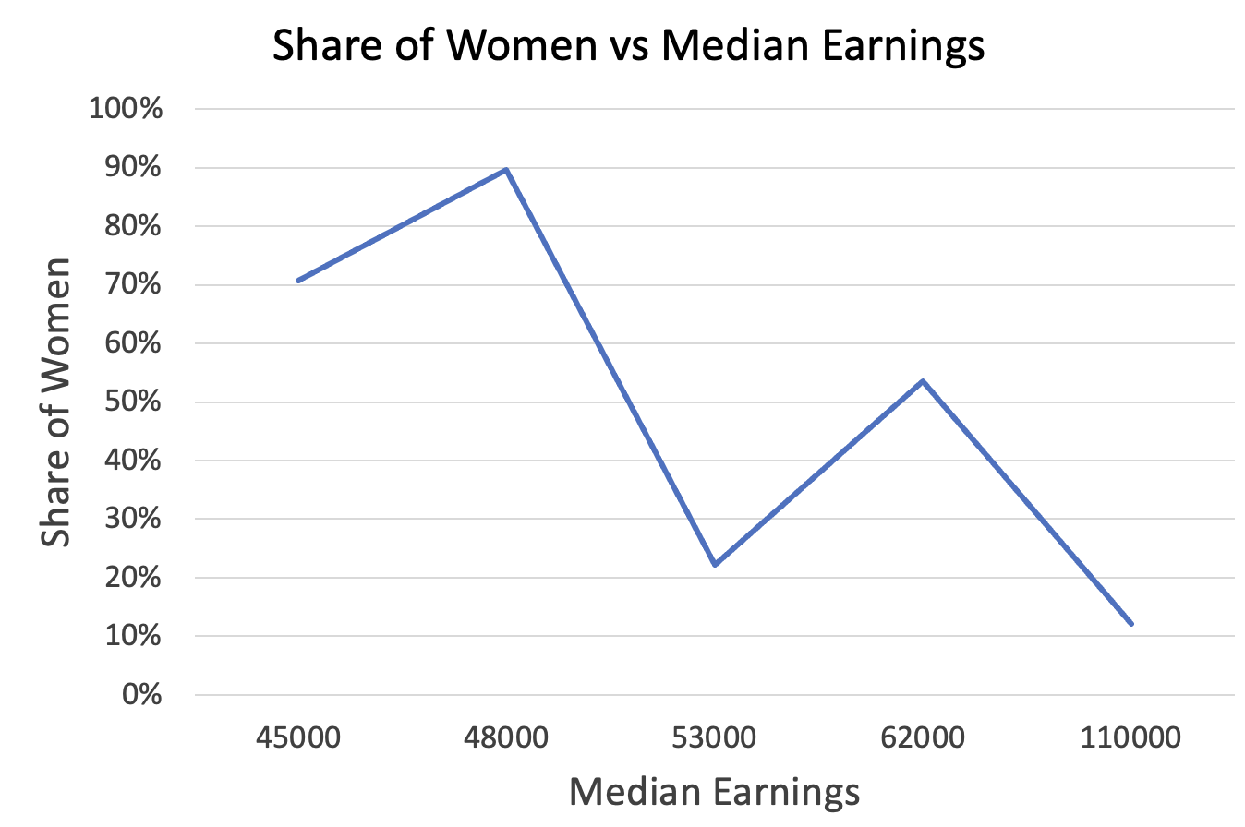
Line charts
Goal → Trend
Data Types → Ordinal or Quantitative vs. Quantitative
Data: https://github.com/fivethirtyeight/data/blob/master/college-majors/women-stem.csv
Notes:
Next, let’s look at line charts.
Line charts are appropriate when we want to view a trend in quantitative data versus some other quantitative or ordinal data.
Let’s say for example here we want to see the trend in share of women as median earnings increases. A line chart with median earning on the x-axis and share of women on the y-axis accomplishes this goal.

Slide 21

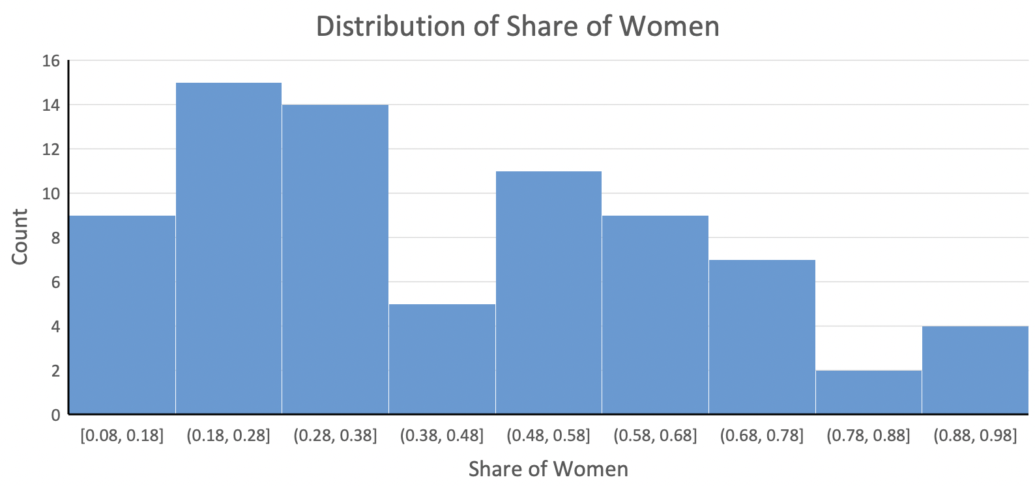
Histogram
Goal → Distribution
Data Types → Ordinal or Quantitative vs. Quantitative
Data: https://github.com/fivethirtyeight/data/blob/master/college-majors/women-stem.csv
Notes:
Next, let’s look at line charts.
Line charts are appropriate when we want to view a trend in quantitative data versus some other quantitative or ordinal data.
Let’s say for example here we want to see the trend in share of women as median earnings increases. A line chart with median earning on the x-axis and share of women on the y-axis accomplishes this goal.

Slide 22
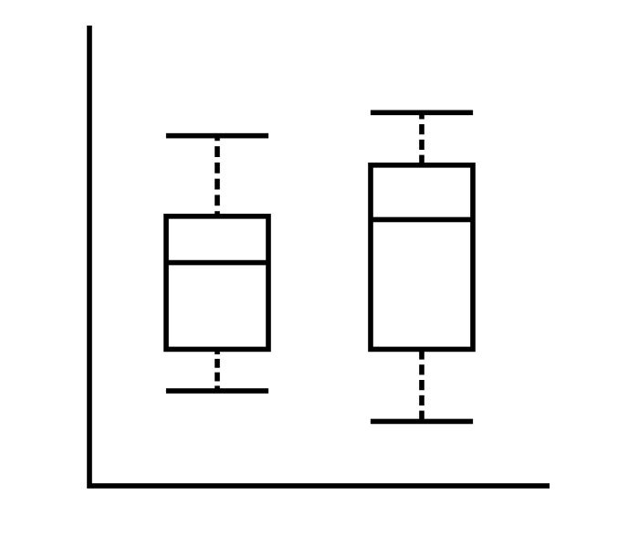
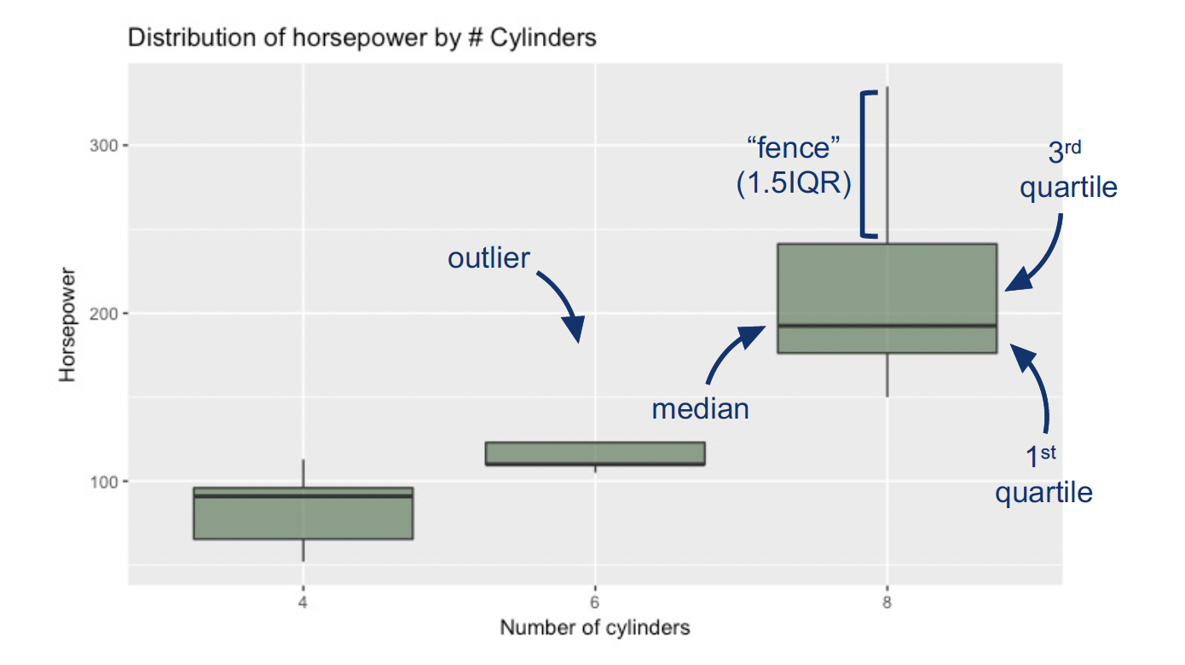
Boxplot
Notes:
Next, let’s look at line charts.
Line charts are appropriate when we want to view a trend in quantitative data versus some other quantitative or ordinal data.
Let’s say for example here we want to see the trend in share of women as median earnings increases. A line chart with median earning on the x-axis and share of women on the y-axis accomplishes this goal.

Slide 23
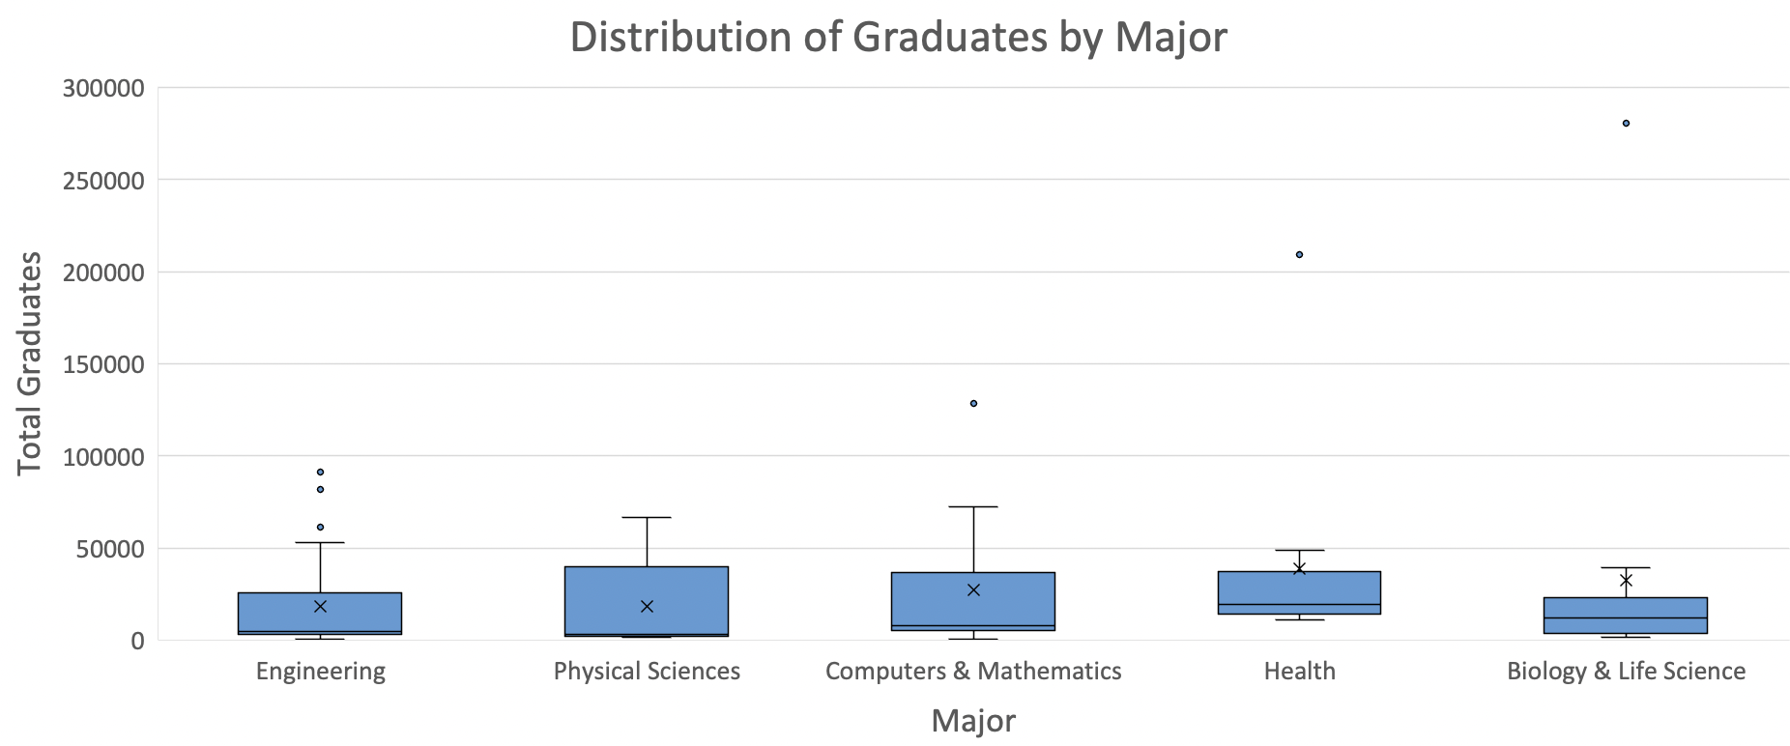
Boxplot
Goal → Distribution
Data Types → Ordinal or Categorical vs. Quantitative
Data: https://github.com/fivethirtyeight/data/blob/master/college-majors/women-stem.csv
Notes:
Next, let’s look at line charts.
Line charts are appropriate when we want to view a trend in quantitative data versus some other quantitative or ordinal data.
Let’s say for example here we want to see the trend in share of women as median earnings increases. A line chart with median earning on the x-axis and share of women on the y-axis accomplishes this goal.

Slide 24
Common Visualizations
Break into groups of 2 – 3
Go to the Jamboard here: Visualization Examples
Select one page of the Jamboard with a specific visualization to work on
Add your names to that page so your classmates know it’s taken
Find your visualization here: https://datavizproject.com/
On the Jamboard record the goal and data type(s) for that visualization
Be prepared to share with the class
If you finish early pick another visualization!

